Slide 1
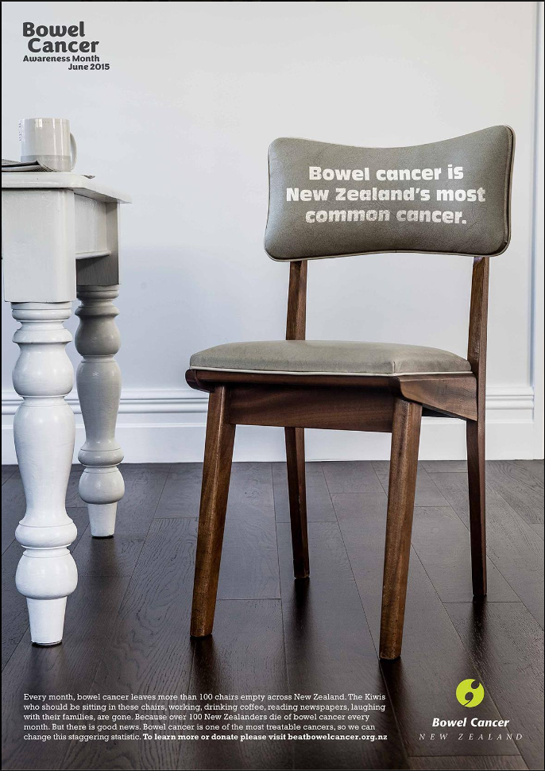
A nationwide, patient-led organisation committed
to reducing the impact of bowel cancer on our
community through awareness, education,
support & research.
What can the people do?
>3000 colorectal cancer diagnoses per year
>1200 deaths per year
Screening saves lives; 350 excess deaths in New
Zealand each year compared to Australia’s rate
Yet still we wait… &
Continue to die
Kiwi Men
have the third highest rate of bowel cancer in OECD countries.
NZ Women
have the highest rate of bowel cancer in OECD countries.
NZ HIGHEST
rate of bowel cancer and bowel cancer death in the developed world.
1200 New Zealanders die each year from Bowel Cancer
Why does New Zealand’s policy-making about bowel cancer screening lag so far behind the ground-swell of profound public concern?
www.beatbowelcancer.org.nz

