Slide 2
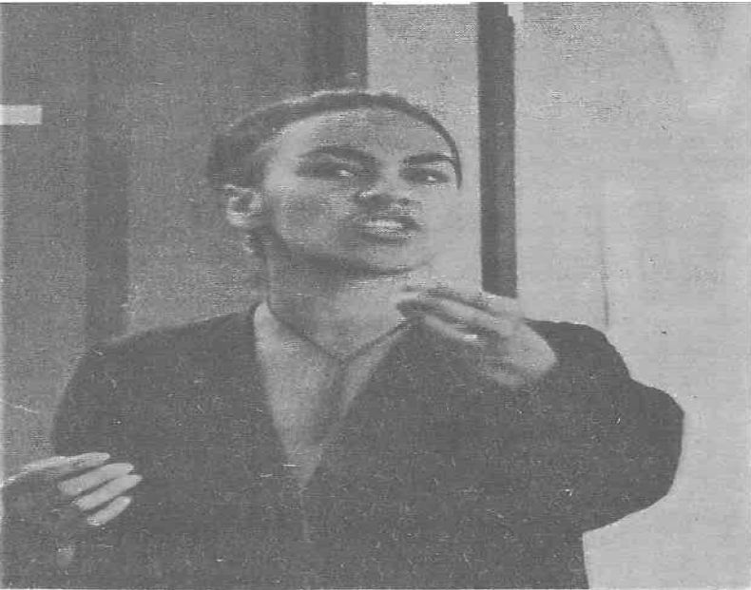
We are not dangerous or subversive perverts, but real & thinking individuals: why should we hide our faces while the public exposes its bigotries?
Why should we be invisible?
NteA in Craccum 15 July 1971 page 6
Auckland University

Slide 3
