Slide 1
Breast cancer screening
Diana Sarfati
Director, Cancer Control and Screening Research Group

Slide 2
Breast cancer
Most common cancer for women in NZ
600 women die each year from breast cancer

Slide 3
Trends in age standardized Incidence rates of breast cancer by time period and ethnic group
Cunningham R, Shaw C, Blakely T, Atkinson J, Sarfati D. Ethnic and socioeconomic trends in breast cancer incidence in New Zealand. BMC Cancer 2010: 10; 674. http://www.biomedcentral.com/1471-2407/10/674

Slide 4
Survival rates are improving over time…
Survival has been improving rapidly over last two decades from75% to 87% in 5-year survival between 1991 and 2004.
Soeberg M, Blakely T, Sarfati D et al (2012). Cancer Trends: Trends in Survival by Ethnic and Socioeconomic Group, New Zealand 1991–2004. Wellington: University of Otago and Ministry of Health.

Slide 5
Primary prevention of breast cancer
Risk factors:
Age
Family history or genetic predisposition
Personal history of breast cancer or precancerous lesions
Reproductive factors
Hormone treatments
Alcohol consumption
Obesity (for post-menopausal breast cancer)
Exposure to ionizing radiation
(Smoking)

Slide 6
Primary prevention of breast cancer
Risk factors:
Age
Family history or genetic predisposition
Personal history of breast cancer or precancerous lesions
Reproductive factors
Hormone treatments
Alcohol consumption
Obesity (for post-menopausal breast cancer)
Exposure to ionizing radiation
(Smoking)

Slide 7
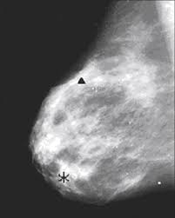
Screening for breast cancer…
There are more RCTs on breast cancer screening than any other cancer screening
Cochrane collaboration, US Preventive Services Taskforce, Canadian Task Force on Preventive Health Care, a UK Independent Review and International Agency for Research on Cancer all concluded that there was evidence of breast cancer mortality reduction in range of 15-32% (depending on age range examined)
Almost all high income countries have mammographic screening established in some form.
Typical breast screening participants are not 25 year old supermodels…

Slide 8
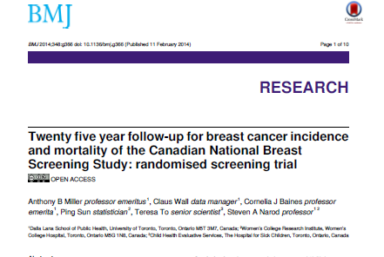
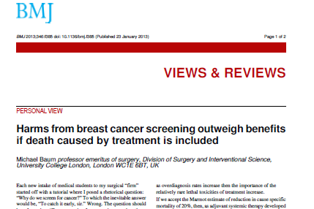
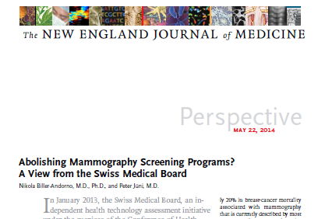
But there is controversy?
Why?
How good were the studies?
What are the harms of breast cancer screening?
Are the findings from old RCTs still relevant given treatment improvements?

Slide 9
How good were the studies?
Concern re methodological quality of some of the RCTs
Varying emphasis put on the importance of these (e.g. Cochrane vs UK Review)
Notes:
Cochrane authors: published widely cautioing against screening: Excluded all but 3 studies and found a non significant reduction of 10% after 13 years (0.90; 0.79-1.02_
UK Review concluded that while there were methodological shortcomings, these were not enough to preclude using results from the studies

Slide 10
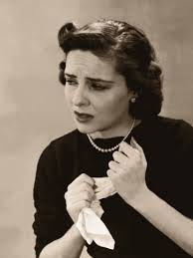
What are the harms of breast cancer screening?
False positive tests
Estimate from recent IARC work that there is a 20% chance that a women attending screening every two years from ages 50 to 70 years will require some sort of follow up. Only 5% requiring invasive procedure.
Over-diagnosis
Huge controversy
Estimates vary substantially (from <5% to >50% of cancers diagnosed).
Excess cancers due to radiation exposure

Slide 11
Are the findings of ‘old’ RCTs still relevant?
Many of the RCTs were conducted in the 1970-80s.
Treatment of breast cancer has improved substantially since then.
Argument is that earlier diagnosis may no longer be particularly relevant.

Slide 12
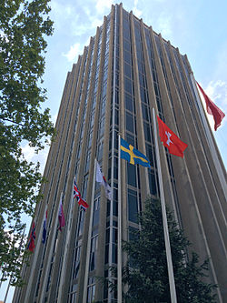
Current recommendations
Most recent recommendations are from IARC
Reviewed RCT and high quality observational study evidence.
Sufficient evidence that breast cancer reduces mortality for women aged 50-74 yrs
Limited evidence that breast cancer reduces mortality for women aged 40-49 yrs.
Estimate that over-diagnosis is likely to be in 1-10%.
These recommendations are consistent with most other major reviews
Lauby-Secretan B, Scoccianti C et al. Breast-cancer Screening – Viewpoint of the IARC Working Group. NEJM 2015 372: 2353-8.

Slide 13
Where to from here?
Should we be screening women under the age of 50 yrs?
Benefits are less and harms are greater
Communicating benefits and harms to women
Emerging new imaging techniques
Tomosynthesis
MRI
PET scans
Ultrasound scans
Notes:
Positron emission tomography

Slide 15
Where to from here?
Should we be screening women under the age of 50 yrs?
Benefits are less and harms are greater
Communicating benefits and harms to women
Emerging new imaging techniques
Tomosynthesis
MRI
PET scans
Ultrasound scans
Notes:
Positron emission tomography

