Slide 1
An Overview of Cervical Cancer jfsdfkjsdlfjhs Naomi Brewer
The Future of Cancer Screening in New Zealand
Balancing the benefits and risks
Auckland, 7 August 2015

Slide 2
Introduction
In 2012, worldwide:
Estimated 528,000 new cases of cervical cancer
Cervical cancer is fourth most common cancer in women
Seventh most common cancer overall
In 2012, worldwide:
266,000 deaths due to cervical cancer
7.5% of all female cancer deaths
Source: Globocan 2012 (http://globocan.iarc.fr/Pages/fact_sheets_cancer.aspx).

Slide 3
The cause of cervical cancer
Virtually all cervical cancers result from a persistent infection with certain high-risk types of human papillomavirus (HPV)
12 types of HPV now consistently classified as high-risk
8 other types of HPV considered likely to be high-risk
HPV infections very common – lifetime risk ~80%
But, cervical cancer is a rare complication
Most infections clear without causing abnormalities
Sources: Steenbergen RDM, et al. Clinical implications of (epi)genetic changes in HPV-induced cervical precancerous lesions. Nat Rev Cancer 2014; 14: 395-405. Walboomers JM, et al. Human papillomavirus is a necessary cause of invasive cervical cancer worldwide. J Pathol 1999; 189: 12-19. Baseman JG & Koutsky LA. The epidemiology of human papillomavirus infections. J Clin Virol 2005; 32 (Suppl 1): S16-S24.

Slide 4
Cervical cancer in New Zealand in 2011
Cervical cancer 12th most common cancer in women
23rd most common cancer overall
21st most common cause of cancer death in women
28th most common cause of cancer death overall
Source: Ministry of Health. Cancer: New registrations and deaths 2011. Wellington: Ministry of Health. 2014.

Slide 5
Cervical cancer in New Zealand in 2011 continued
165 new cases of cervical cancer
Age-standardised incidence rate:
5.9 per 100,000 non-Māori women
12.3 per 100,000 Māori women
53 deaths from cervical cancer
Age-standardised mortality rate:
1.4 per 100,000 non-Māori women
5.4 per 100,000 Māori women
Source: Ministry of Health. Cancer: New registrations and deaths 2011. Wellington: Ministry of Health. 2014.

Slide 6
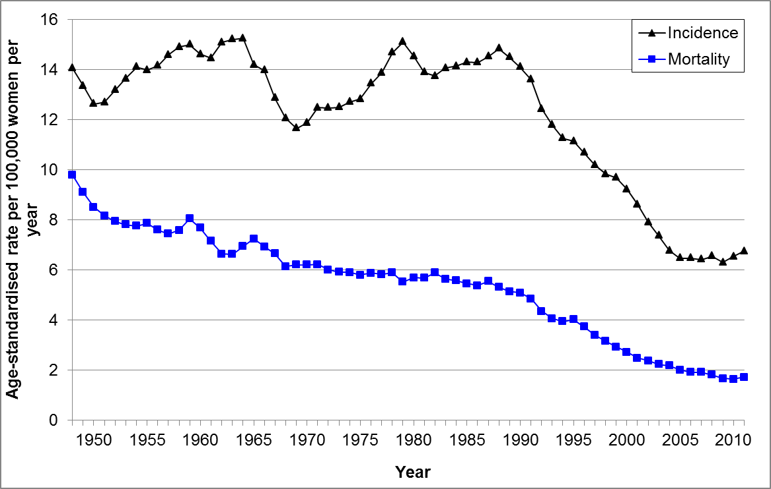
Historical summary
Five-year moving average. Age-standardised to WHO world standard population.
Source: Figure prepared by author using data provided by the Ministry of Health.

Slide 7
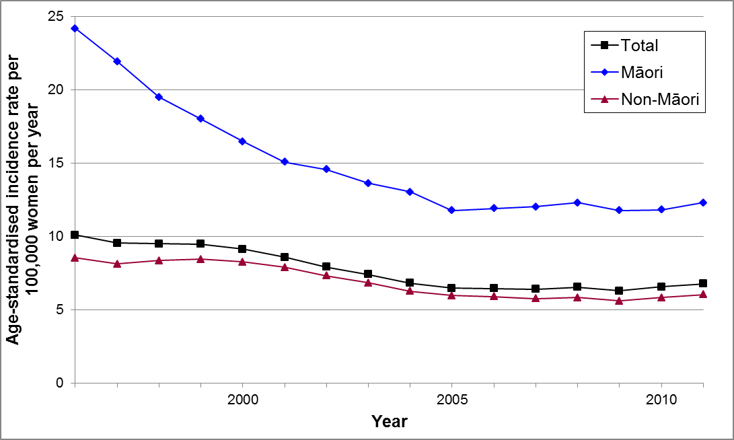
Incidence by ethnicity
Five-year moving average. Age-standardised to WHO world standard population.
Source: Figure prepared by author using data provided by the Ministry of Health.

Slide 8
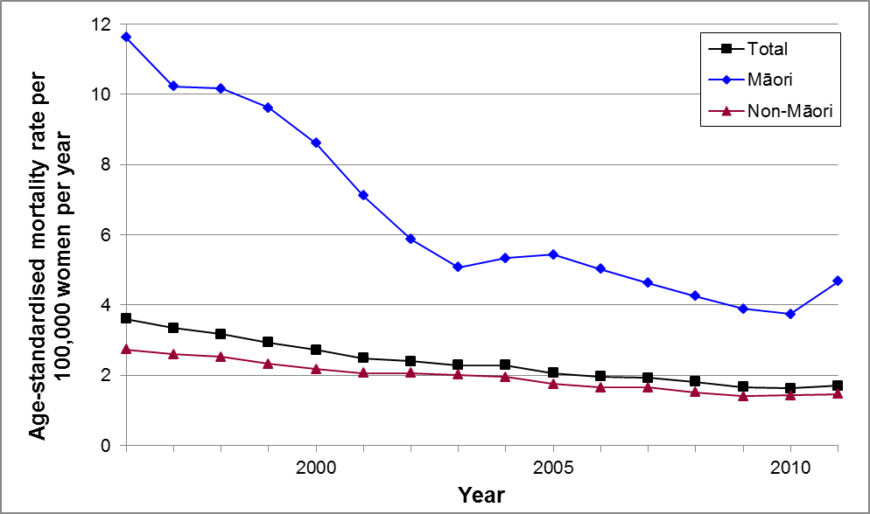
Mortality by ethnicity
Five-year moving average. Age-standardised to WHO world standard population.
Source: Figure prepared by author using data provided by the Ministry of Health.

Slide 9
Some possible explanations
Screening history
Stage at diagnosis
Comorbid conditions
Treatment
Source: Epidemiological studies of cervical cancer survival in New Zealand: a thesis presented in partial fulfilment of the requirements for the degree of Doctor of Philosophy in Epidemiology at Massey University, Wellington Campus, New Zealand. ﻿Brewer, Naomi. 2011

Slide 10
Prevention
Immunisation
– the HPV vaccine (Gardasil® used in NZ)
Smear test (cytology screening)
– cytology with high-risk HPV triage in women ≥30 years to help assess risk of progression
HPV with cytology triage
– self-sampling for HPV testing
Source: https://www.nsu.govt.nz/national-cervical-screening-programme

Slide 11
Conclusions
Cervical cancer is gradually becoming less common & fewer women dying from cervical cancer in NZ
But, the decreases are not evenly distributed across the population
Effective methods for the prevention of cervical cancer now exist and work is continuing to improve these methods

