Slide 1
Preventing cancer
Diana Sarfati
Director, Cancer Control and Screening Research Group

Slide 2
Onset of symptoms and/or signs
Early detection
Exposure
Onset of disease
D1 Cure
A
B
C
D2 Disability
D3 Death
Primary prevention
Secondary prevention
Tertiary prevention

Slide 3
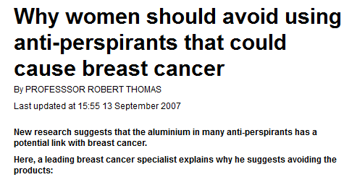
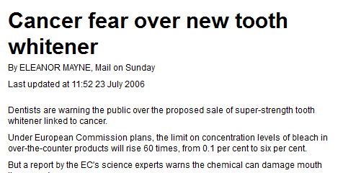
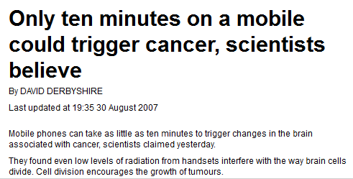
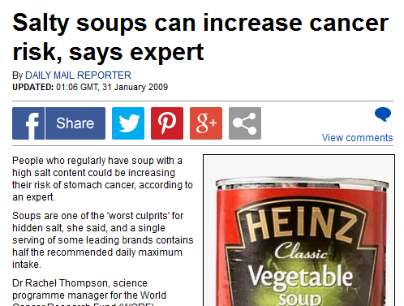
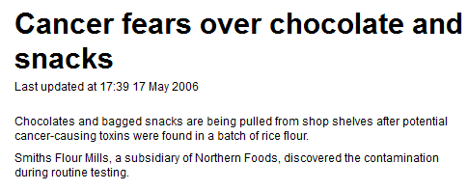
Everything gives you cancer?
Up to half of all cancers could be prevented by changes in lifestyle factors.
Confusion created by frequent media stories…

Slide 4
The BIG
8
Dart et al. Cancer Causes Control 2012

Slide 5
1. Don’t smoke
Smoking is number one preventable cause of cancer
Causes almost all cases of lung cancer
Increases cancers of upper airway, stomach, mouth, tongue, liver, cervix, bladder…
So: Don’t start smoking
If you smoke, quit. Your risk of cancer starts coming down about two years.
Plus you reduce your chance of other chronic diseases including heart disease, emphysema and bronchitis

Slide 6
NZ Adult (age 15+) Daily Smokers (%) 1996 - 2014

Slide 7
Māori Adult (age 15+) Daily Smokers (%) 2006 - 2014

Slide 8
Pacific (age 15+) Daily Smokers (%) 2006 - 2014

Slide 9
2. Keep your weight in the healthy range.
Being overweight or obese is one of the most important risk factors for a number of cancers.
Increases risk of bowel, breast, kidney, stomach, uterine…
Plus you’ll reduce your chance of developing heart disease, diabetes, stroke, arthritis…

Slide 10
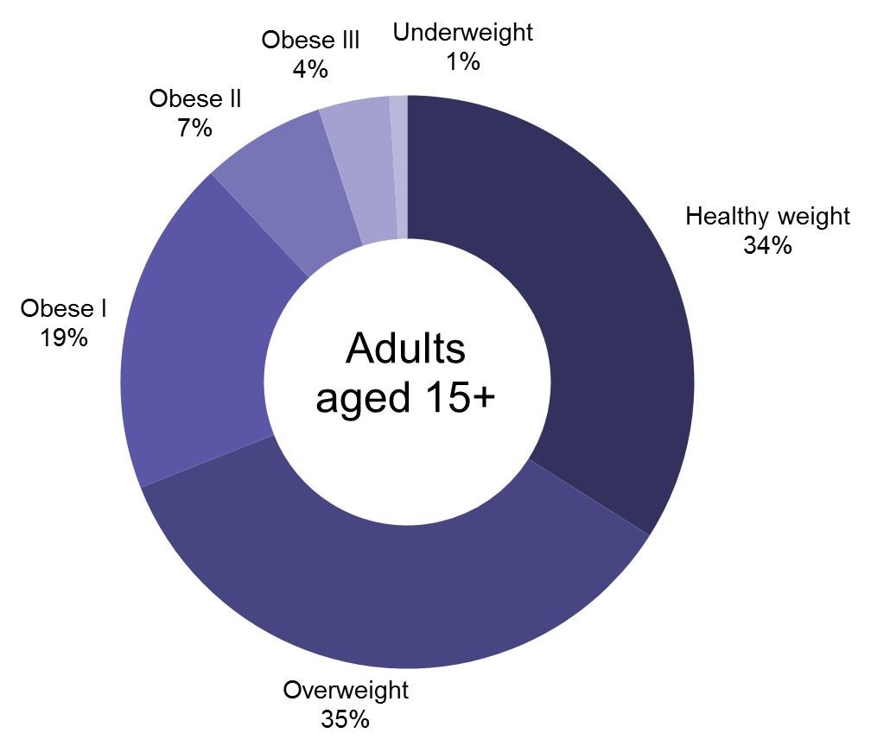
Proportion of adults in each BMI category, 2011–2013
Ministry of Health. 2015. Understanding excess body weight. NZ Health Survey.

Slide 11
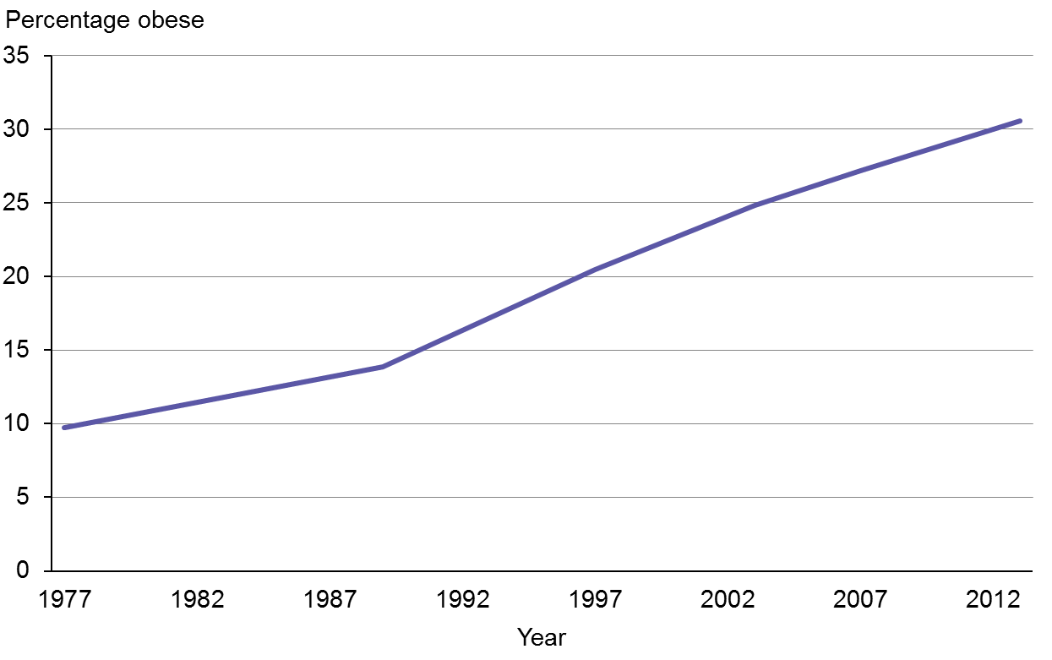
Adult obesity rate, 1977*–2012/13
Ministry of Health. 2015. Understanding excess body weight. NZ Health Survey.

Slide 12
3. Exercise regularly
Will reduce your chances of developing colon and breast cancers.
Plus you’ll be at reduced risk of heart disease, diabetes and osteoarthritis.

Slide 14
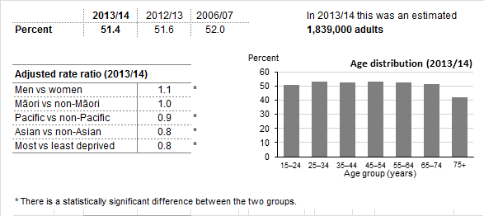
Adults who were physically active for at least 30 minutes on five or more days in the last week
Ministry of Health. Key Results 2013/2014: NZ Health Survey

Slide 15
4. Drink little or no alcohol
Drinking alcohol is related to increased risk of breast, colon and liver cancers.
Even a little bit increases the risk

Slide 16
5. Eat a healthy and varied diet
Keep calories in healthy range.
Eat plenty of plant-based foods including fruit, nuts and whole grains.
Keep diet low in salt and processed meats
Associated with lower risk of cancers of breast, colon, oesophagus and stomach.
Plus you’ll lower your risk of heart disease and diabetes.

Slide 17
6. Avoid excess sun exposure
Sun in NZ is particularly harsh.
Causes thousands of skin cancers every year.
Keep out of the sun in the middle of the day, wear protective clothing, sun glasses, a hat and sunscreen (you know the drill)

Slide 18
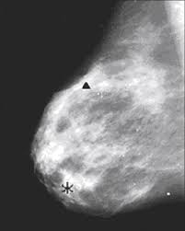
7. Get regular (evidence-based) screening
There is good evidence that regular, organised screening reduces risk of dying from breast, cervical and bowel cancers.
Cervical and bowel cancer screening can actually prevent cancer
Be aware of risks and benefits of screening.

Slide 19
8. Avoid chronic infections
Hepatitis B and C cause liver cancer
Human papilloma virus causes cervical cancer
Helicobacter Pylori causes stomach cancer

Slide 20
Stomach cancer
Age-standardised incidence rates per 100,000: Males 25+ yr +
Blakely T, et al. (2010) Cancer Trends: Trends in Incidence by Ethnic and Socioeconomic Group, New Zealand 1981–2004. Wellington
Notes:
Increasing over time
Large ethnic differences
Poor survival overall with some evidence of ethnic differences in survival

Slide 21
What causes stomach cancer?
Helicobacter Pylori
Stomach cancer

Slide 22
Estimated seroprevalence of H Pylori by birth cohort and ethnicity in New Zealand
McDonald A, Sarfati D, Baker M, Blakely T Trends in Helicobacter pylori infection among Māori, Pacific and European birth cohorts in New Zealand. Paper under review

Slide 23
Contribution of H pylori to stomach cancer
McDonald A. Casting a long shadow: the role of household crowding on Helicobacter pylori infection, and excess stomach cancer incidence among Māori and Pacific people. Masters dissertation 2013. (Paper in preparation)

Slide 24
What causes stomach cancer?
Helicobacter Pylori
Stomach cancer

Slide 25
What causes stomach cancer?
Helicobacter Pylori
Overcrowding in childhood
Stomach cancer

Slide 26
What causes stomach cancer?
Colonisation
Immigration
Helicobacter Pylori
Overcrowding in childhood
Stomach cancer
Deprivation
Income

Slide 27
Preventing cancer…
Dahlgren, G and Whitehead, M (1991)
Notes:
Whitehead

Slide 28
The Big 8
Don’t smoke
Keep your weight in the healthy range.
Exercise regularly
Drink little or no alcohol
Eat a healthy and varied diet
Avoid excess sun exposure
Get regular (evidence-based) screening
Avoid chronic infections

Slide 29
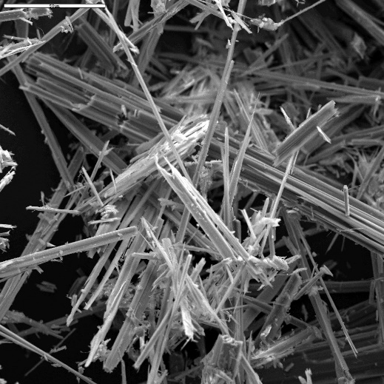
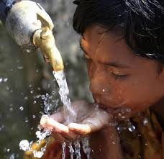
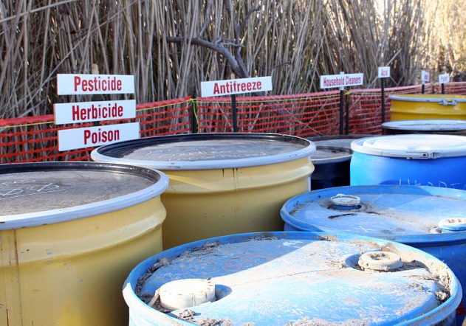
Other causes
Occupational
Asbestos, heavy metals, many other individual exposures
Environmental
Arsenic contamination, Aflatoxins in foods, Indoor air pollution, Asbestos
Immunosuppression
Notes:
Occupational exposures: esp in newly industrialised countries eg asbestos and heavy metals
Environmental pollution air; water; soil est 1-4% of cancers

